Slide 1
What is Privacy?

Slide 2
Privacy Definition
Control of access to ourselves

Slide 3
Privacy: Control of access to ourselves
Control of access
  We expose ourselves to others to varying degrees
    Our name and image of our face is available to many
    Closer details are limited to friends/family
    Deepest aspirations/desires/fears restricted to self + intimates
  Privacy: Not correspond with any one personal exposure level
  Privacy: Ability to maintain exposure distinctions
    Privacy is control over who receives access to what part of ourselves

Slide 4
Privacy: Control of access to ourselves
To ourselves
  Access to ourselves involves our:
    Driving desires/fears/emotions
    Guiding memories and aspirations
    Defining numbers and measurements
    Capturing images
    Incarnating bodies
  All the ways that we can be conceived as individuals

Slide 5
Privacy versus secrecy
Privacy: Not a synonym for secrecy
Privacy: Ability to decide what remains secret, and from whom

Slide 6
Privacy vs being left alone (Ethics vs Law)
Legal definition privacy: Right to be left alone
    Justice Brandeis, Olmstead v. United States, 277 U.S. 438 (1928)
Philosophy/Ethics of privacy: Control access to self
  Private moment may be solitary, may involve many others (who refuse to leave you alone)
    Private moment examples: Quiet marriage proposal, crowded wedding ceremony
  Privacy exists when you determine who’s there
  Privacy is about control, not about others

Slide 7
Privacy lost as exposure
Definition of lost privacy ≠ Others access you
Definition of lost privacy = Exposure
  You may be accessed
  Vulnerable to others’ explorations of your:
    Activities and associations
    Dimensions and appearance
    Desires/aspirations/fears

Slide 8
Privacy as a verb, not a noun
Privacy not something we have, privacy is something we do
Privacy not a possession, privacy is an ability/power

Slide 9
Privacy Examples (1 of 2)
End of beach day: people on the sand nearby notice I’ve wrapped myself in towel and dropped off my wet swimsuit underneath.
Later, a hidden camera in my hotel room snaps pictures of me wrapped in the same towel after my shower.
Two identical views of me, but difference of control
Split = divide between privacy / privacy’s violation

Slide 10
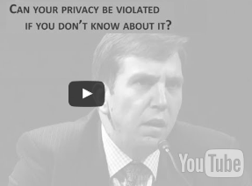
Privacy Examples (2 of 2)
US Congressional Hearing: Surveillance & Privacy
  Congressman maintains: Individuals' privacy can’t be violated if they don’t know their information has been gathered
  “Your privacy can’t be violated if you don’t know it has been violated.”
http://bit.ly/2qKgSRx
Response: If our information collected without our knowledge, then by definition privacy lost because we have lost control of access to ourselves

Slide 11
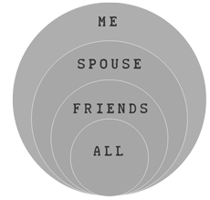
Envisioning privacy: Concentric circles
The subject occupies outermost circle: access to all information
Next interior circle: access to all except the subject’s most intimate truths
Curated access for subject’s friends/family
Open access
Those inhabiting each ring access everything within their circle, but cannot penetrate information outside
Privacy = Ability maintain circles

Slide 12
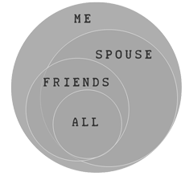
Envisioning privacy: Independent rings
Subject occupies the outermost circle: access to all information
Next interior circle: access to all but the subject’s most intimate truths
Curated access for subject’s friends
Open access
Intimacy contraction not linear
  Friends may access some information unavailable to spouse, etc.
Those inhabiting each ring access everything within their circle, but cannot penetrate information outside
Privacy = Ability maintain rings

Slide 13
Zero-privacy extremes (1 of 2)
Privacy has a negative and a positive expression
Privacy as a negative expression (free from…)
  Defensive = Shield personal information from prying eyes
Zero privacy extreme
  You are completely exposed: Unable to hide anything, from anyone
  Example: You are under constant + complete surveillance
  No control over access to yourself

Slide 14
Zero-privacy extremes (2 of 2)
Privacy has a negative and a positive expression
Privacy as positive expression (free to…)
  Ability to reveal information to others
Zero privacy extreme:
  Entirely muted/alone: Able to disclose nothing, to no one
    If you’re unable to distribute information, you don't control it
  Example: Individual alone on desert island
  No control over access to yourself

Slide 15


Credits
Contact
James Brusseau
Philosophy Department
Pace University, NYC
jbrusseau@pace.edu
JamesBrusseau.net
© 2017

