Slide 1
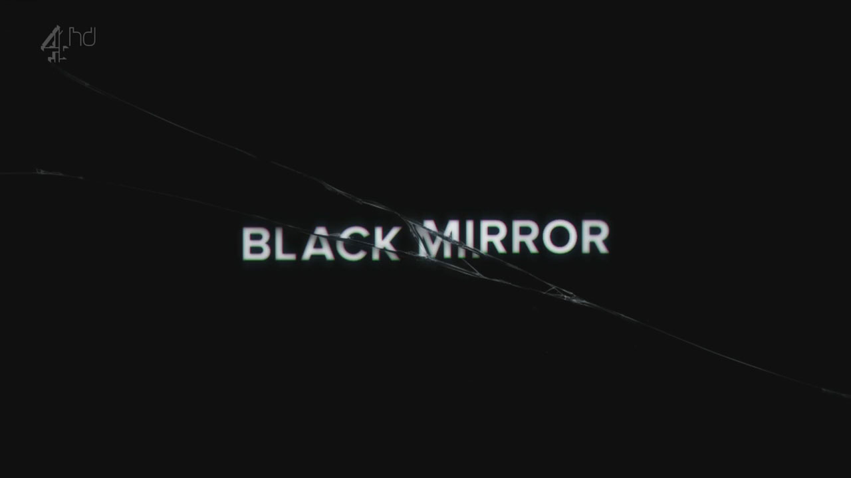
WRITERS’ ROOM

Slide 2
The following sets of slides are intended to show the relationship between current technologies/social implications/ethical controversies and real episodes of Black Mirror.
A reason that Black Mirror is so compelling is that it often builds upon our existing anxieties about technology and pushes them just a step farther. This is the perfect place to build from when using creative speculation to think through the possible consequences of new technology.

Slide 3
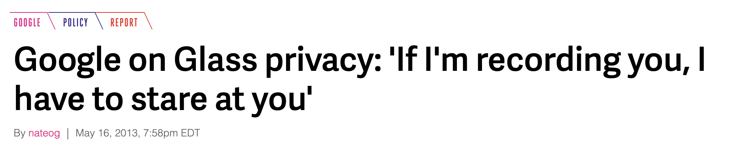
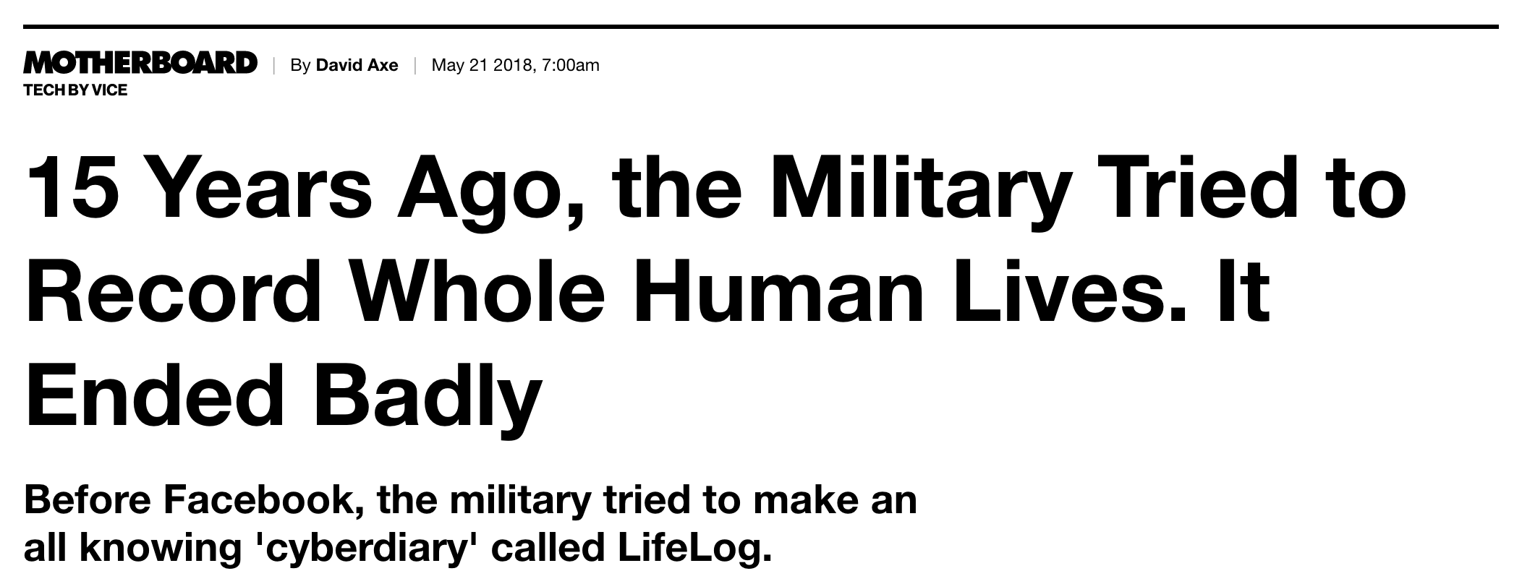

Slide 4
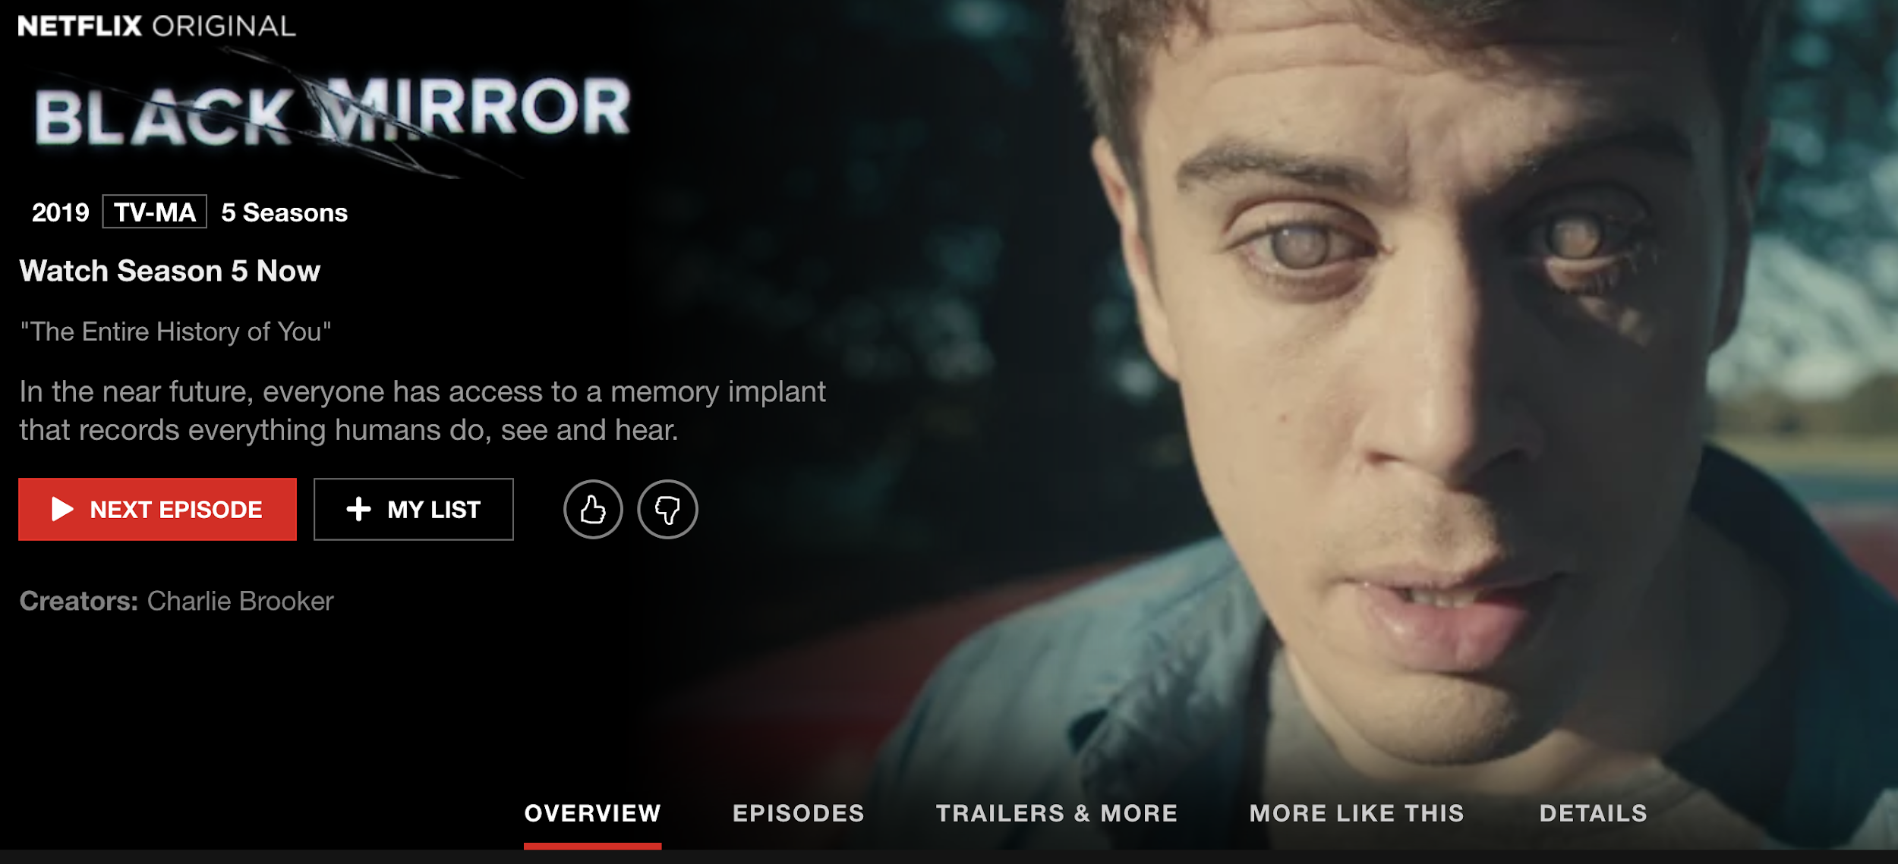

Slide 5
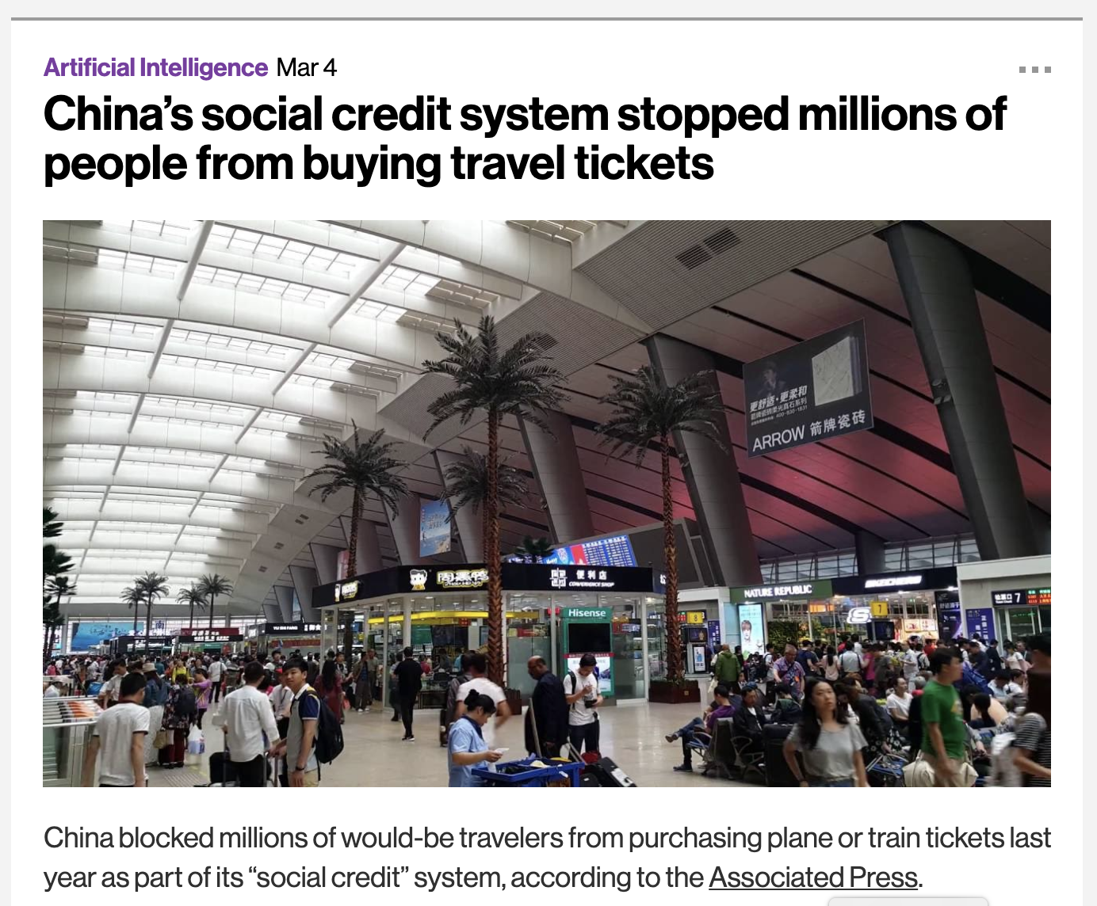
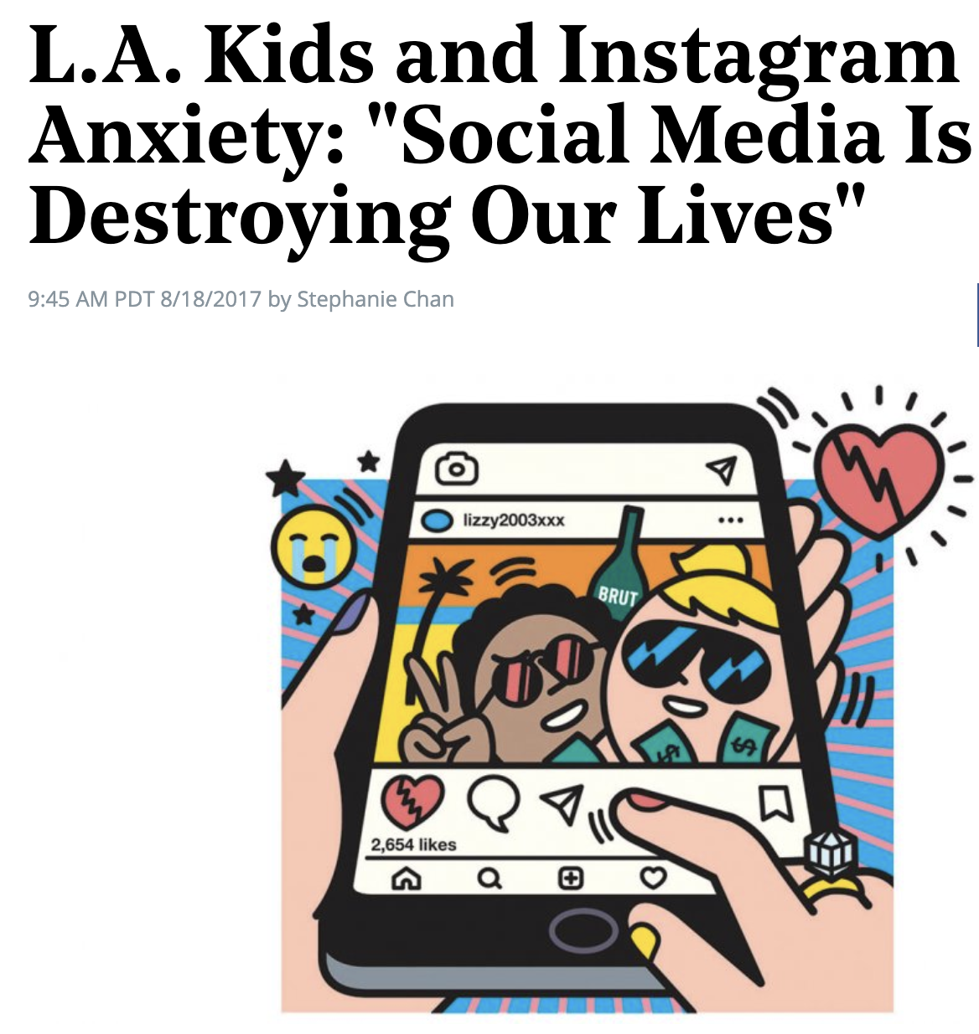
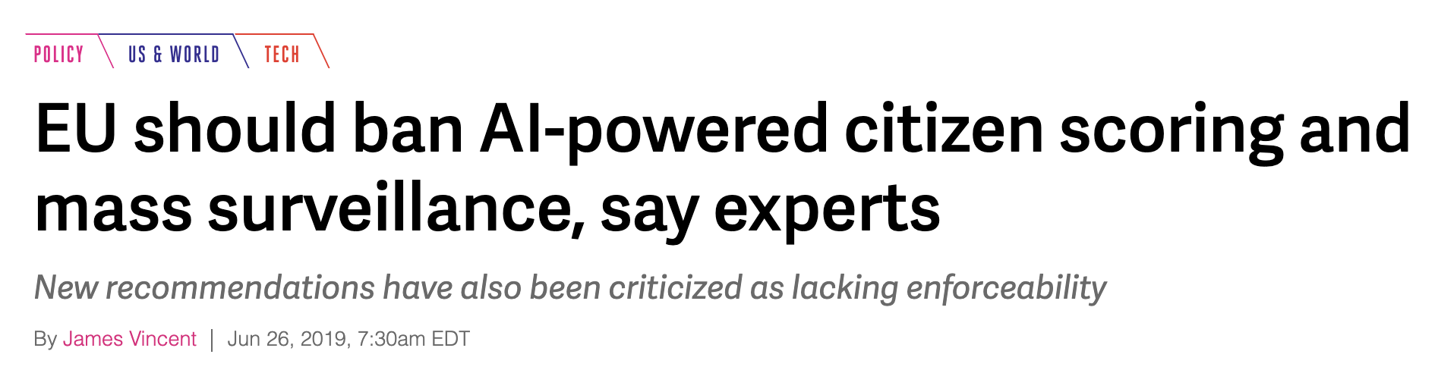

Slide 6
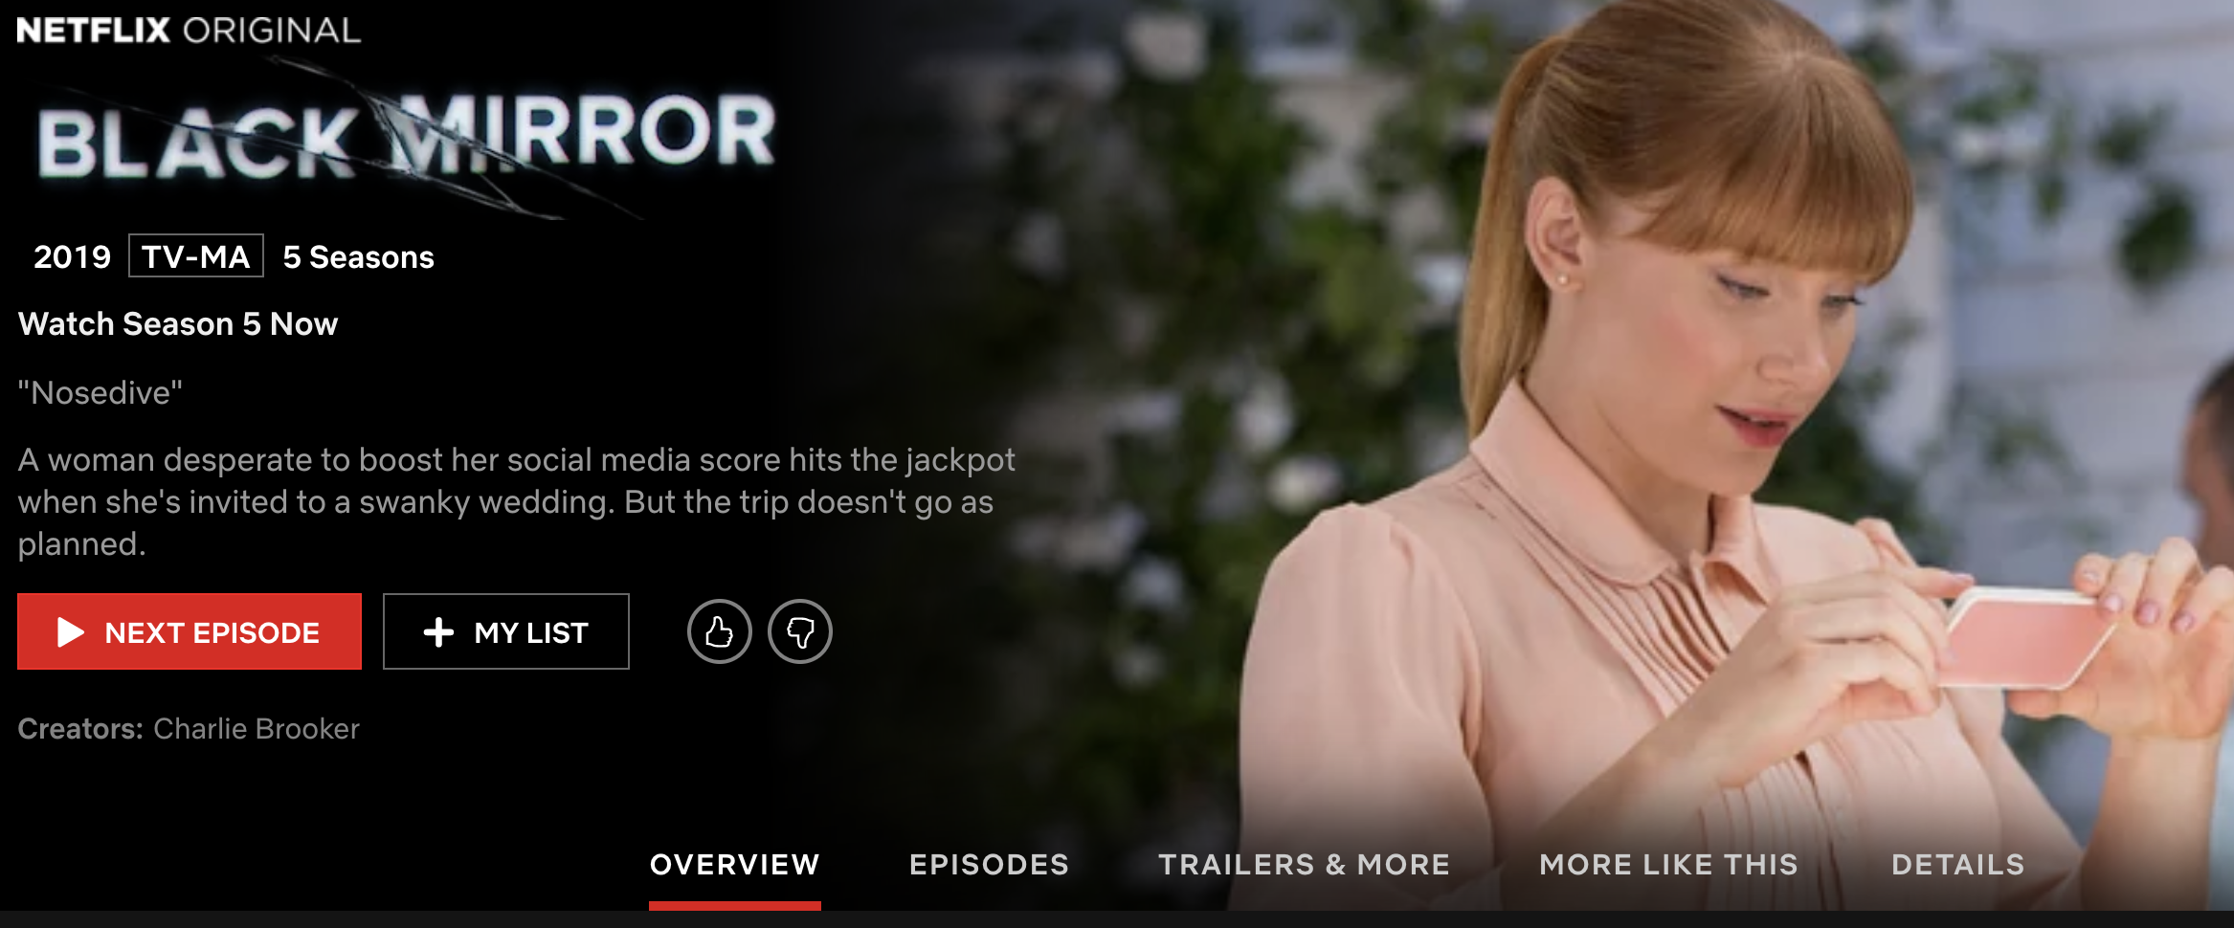

Slide 7
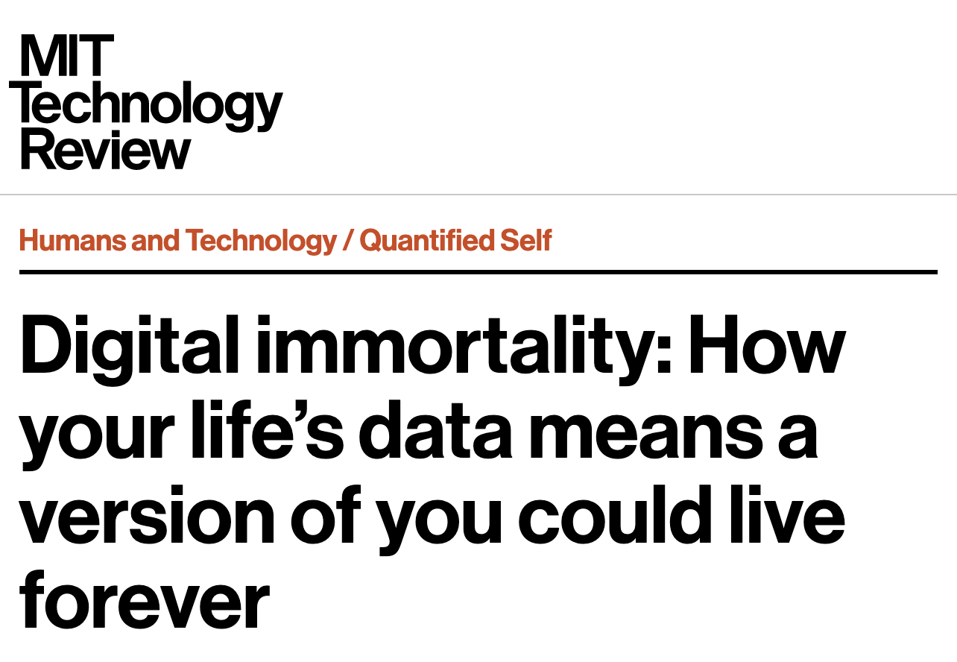
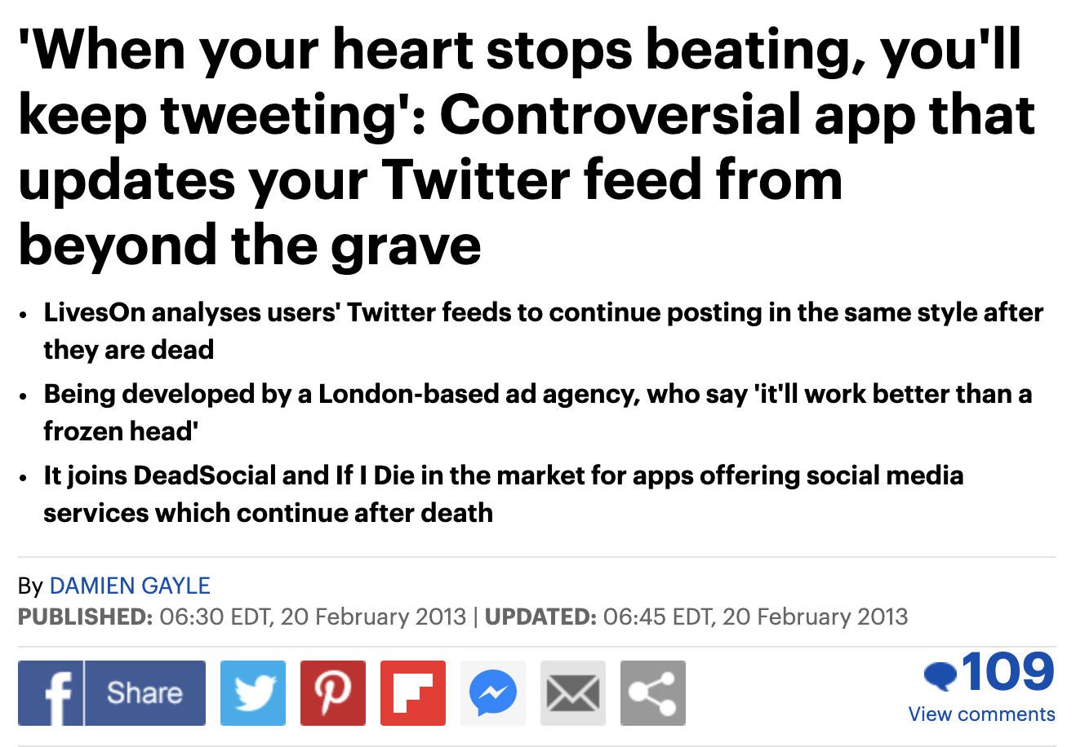

Slide 8
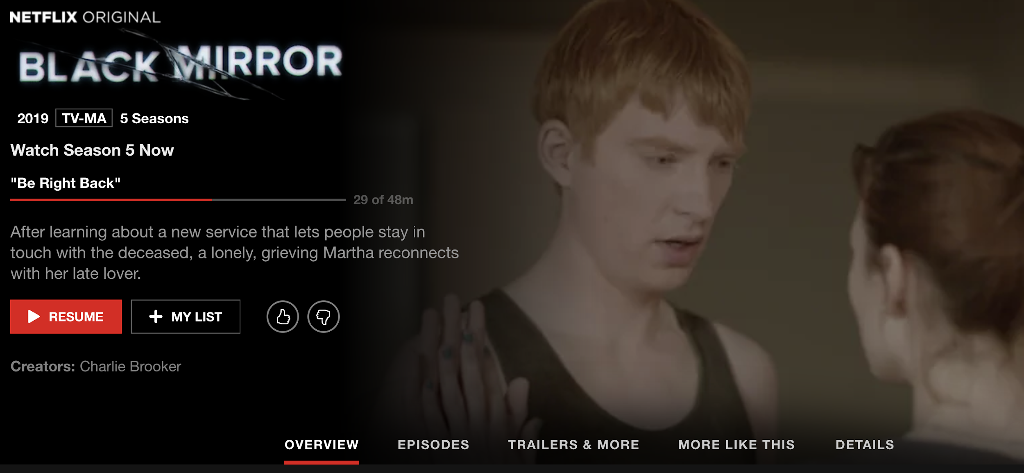

Slide 9
What follows is a description of an exercise that can be run with groups of students - or anyone, really!

Slide 10
1. Brainstorm near future technology based on a topic of your choice. It should be close enough that it seems like a plausible future.
2. What are the potential social implications and/or ethical issues and/or regulatory challenges with this technology?
3. What do you think might be a cautionary tale related to this technology?
4. What fictional person in the future could best illustrate this caution?
5. What is their story?

Slide 11
Example Topics
Algorithmic Bias
Recommender Systems
Self-Driving Cars
Government surveillance
Censorship
Free speech
Internet of things
Predictive policing
Facial recognition/analysis
Social media privacy
Data privacy
Online dating
Robots/AI
Intellectual property
Online harassment
Fake news/misinformation
Job loss due to automation
The digital divide

Slide 12
The following slides are both examples and can be used as templates for creating your own Black Mirror episodes based on this exercise. Note that you will need to make a copy of the deck first. Then just have groups replace the text and image!
Remember not to stop at this step… also have students consider what a “Light Mirror” scenario would be. How can we work towards preventing the negative consequences of the future they envision?

Slide 13
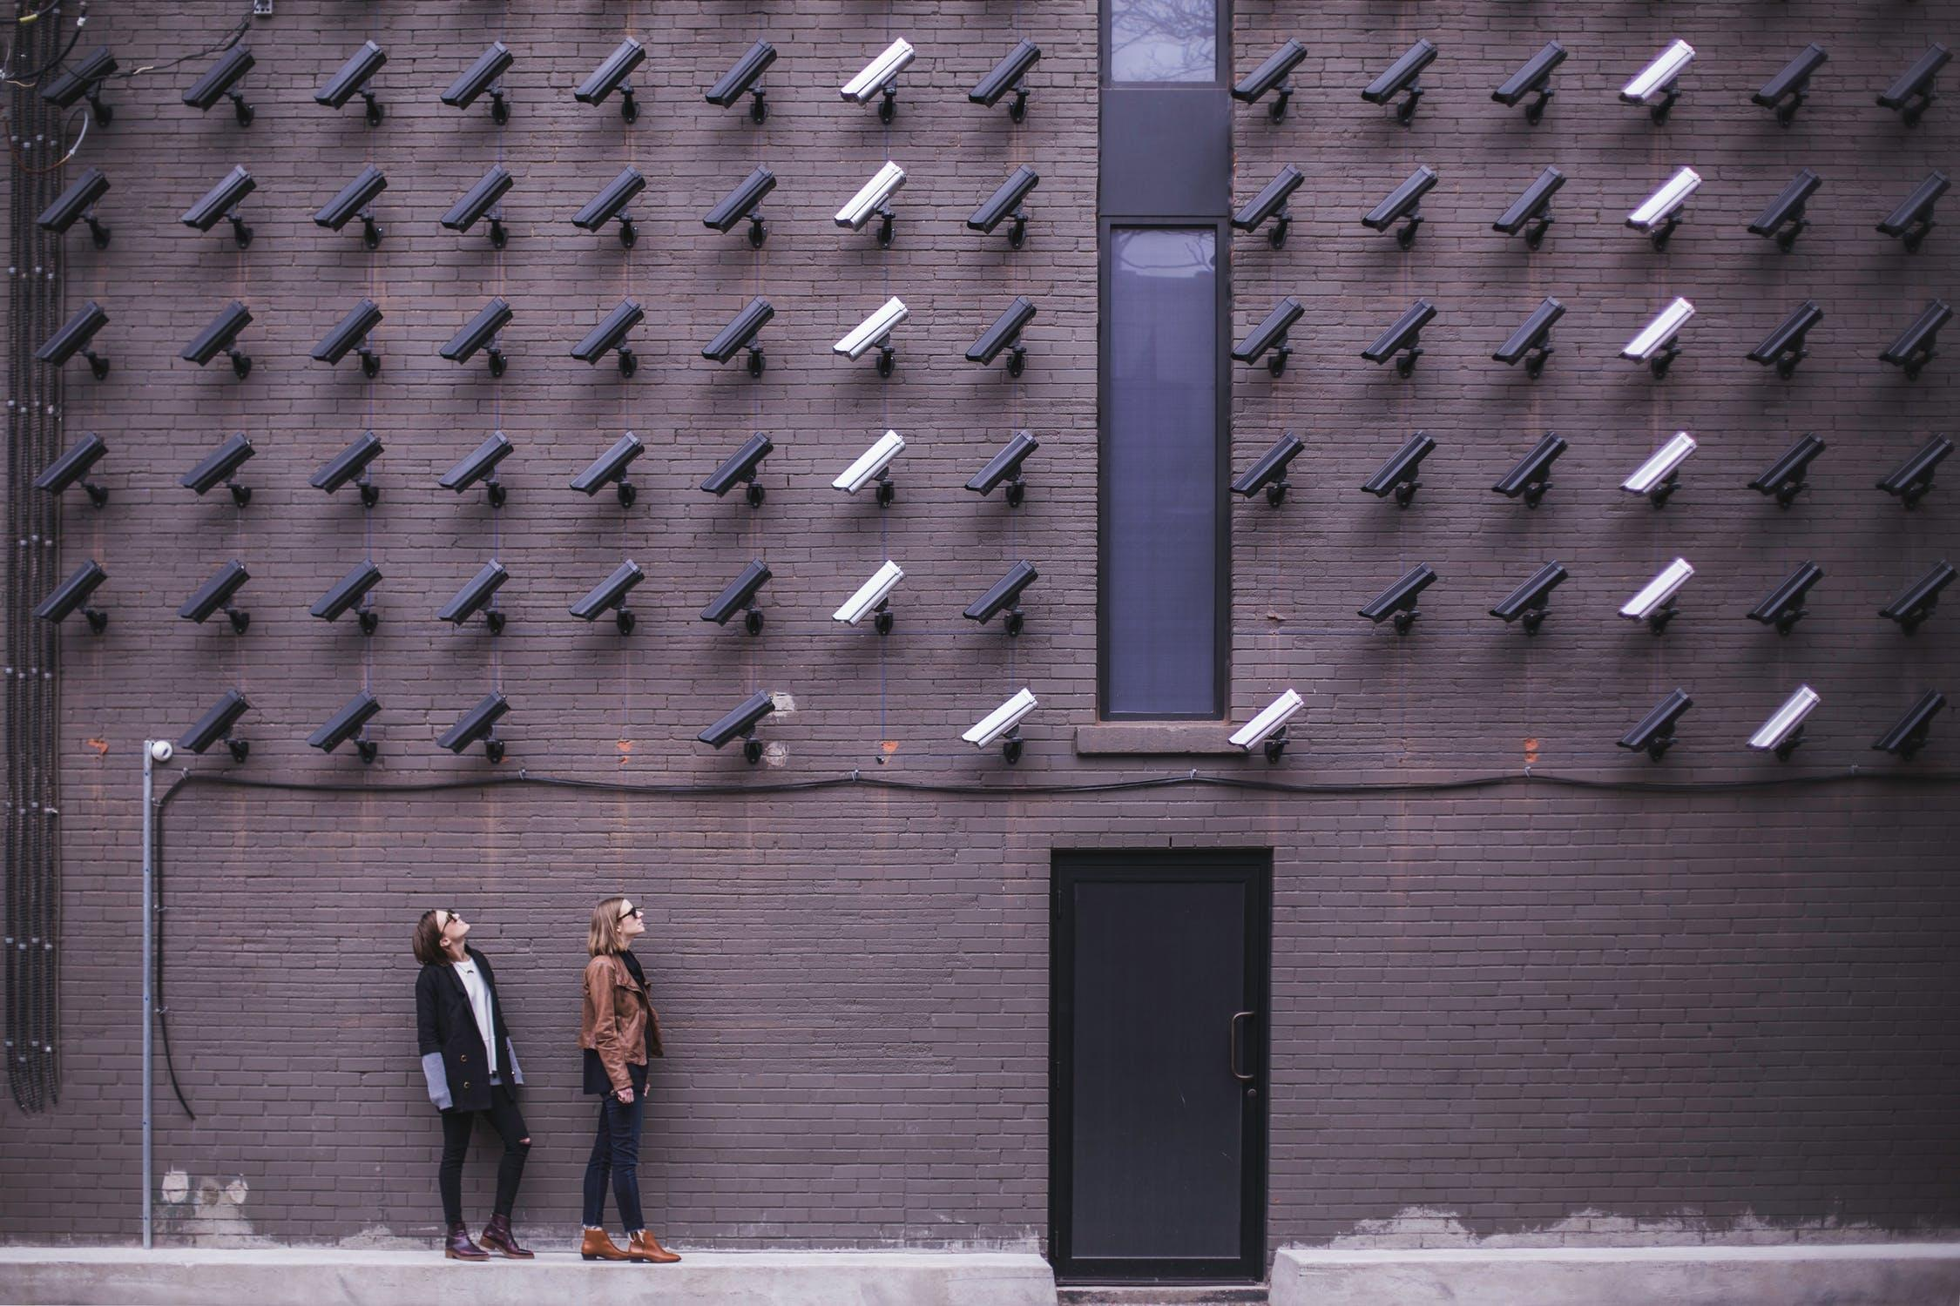
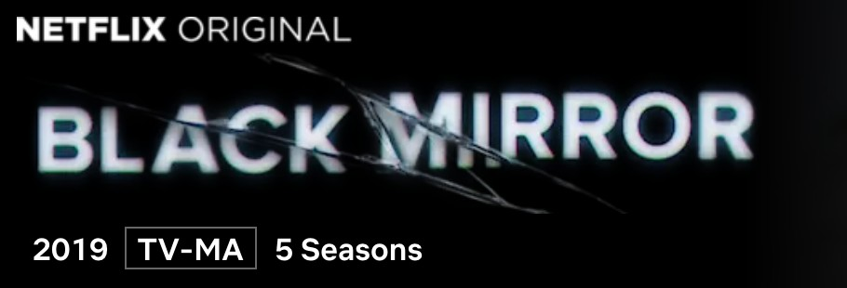

“Put On a Happy Face”
Plagued by an algorithmic error that crashed her social credit score, a woman becomes obsessed with looking good for the massive surveillance system that determines everything about her value to society. But when looking good becomes more important than being good, everyone around her begins to suffer.
Creators: Casey Fiesler
Image Credit: Pexels (Burst, free to use)

Slide 14
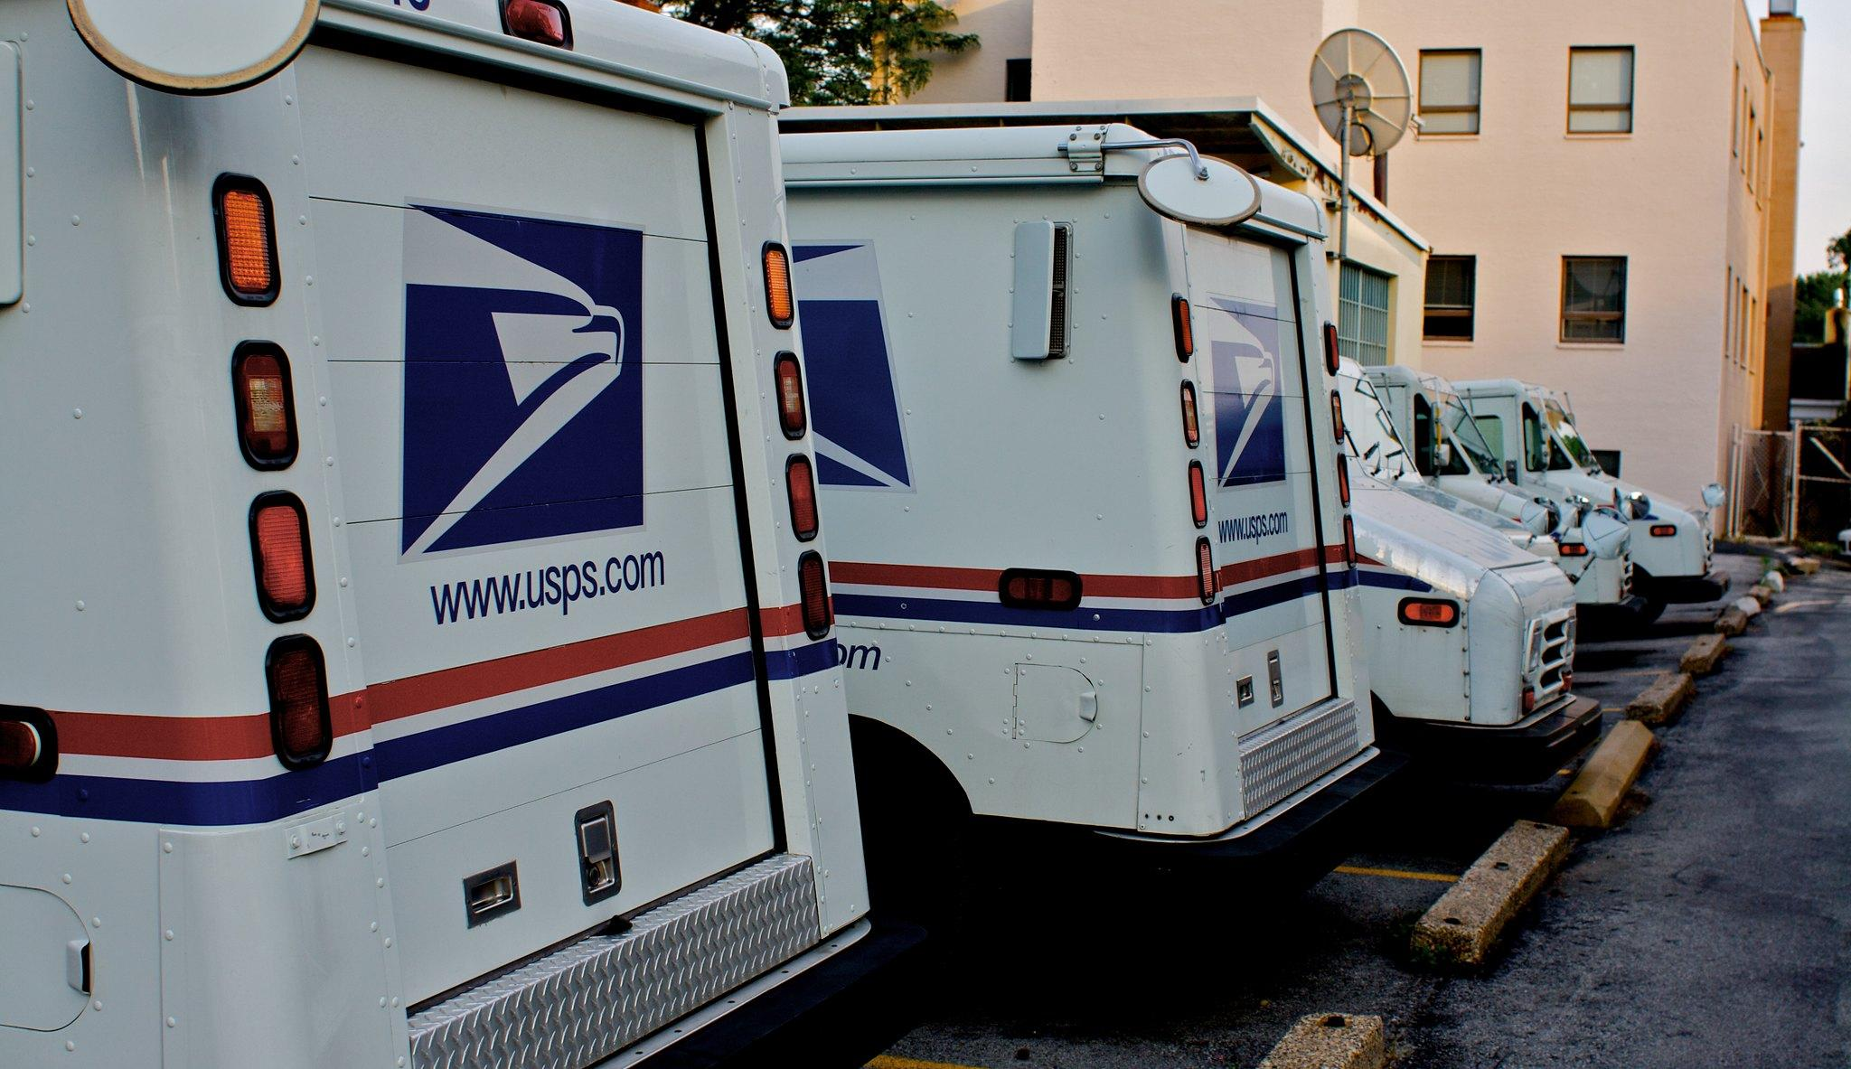
“Special Delivery”
In a data-driven, post-choice future, e-commerce algorithms know so much about you that everything you might want or need simply appears on your doorstep. But when one consumer becomes increasingly unsettled by the assumptions about his life that these deliveries represent, he wonders if what he really wants and needs is… privacy.
Creators: Casey Fiesler
Image Credit: John Cappiello, via Flickr (CC NC-ND-BY 2.0)

Slide 15
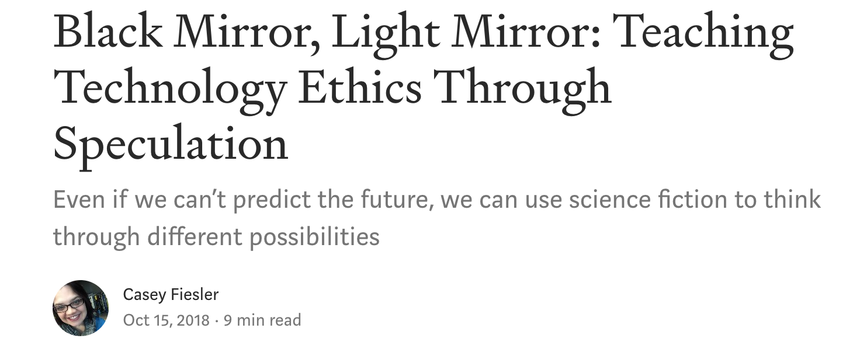
https://howwegettonext.com/the-black-mirror-writers-room-teaching-technology-ethics-through-speculation-f1a9e2deccf4
Please feel free to make a copy of this deck and modify it as you see fit! For questions about this exercise, suggestions on how to make it better, or to share your own experiences with it, you can contact Casey Fiesler (casey.fiesler@colorado.edu) or even better, tweet about it! @cfiesler
www.caseyfiesler.com | www.internetruleslab.com

